Slide 1

Università Politecnica delle Marche
Corso di Laurea Magistrale in Ingegneria Informatica e dell’Automazione
Dipartimento di Ingegneria dell’Informazione
3D Human Pose Estimation based on Convolutional Neural Network and Event-based cameras:
a proof of concept on a DHP19 dataset
Tutor: Prof. E. Frontoni, Prof. A. Mancini
Ph.D. L. Romeo, R. Rosati
Students: L. Lucarelli
A. Manilii

Slide 2
Human Pose Estimation

Slide 3
Introduction
Human Pose Estimation
The problem of human joints localization in images or videos
Applications
Real time applications
Virtual reality
Gaming
Accident detection
Movement feedback in rehabilitation therapy
Traditional dataset problems
Redundancy
Background informations
Low temporal resolution for fast moving objects
Event camera
Higher dynamic range and temporal resolution
Lower power budget
Reduced data-transfer bandwidth
Source: ” Intelligent Fitness Trainer System Based on Human Pose Estimation”
Notes:
Accenno funzionamento camera a eventi

Slide 4
State-of-the-Art
Event-based datasets
3D HPE commonly use frame-based dataset. Most common are: HumanEva , Human3.6M , MPI-INF-3DHP and MADS .
DHP19: the only event-based dataset build for HPE Only two on human gestures or body movements [1],[2] among other event-based datasets.
Source: ‘’ A Low Power, Fully Event-Based Gesture Recognition System’’
Tasks
Approaches for 3D pose reconstruction
CNN have been applied to the output of event-based cameras only to solve:
classification problems [1]
regression problem (single output) [3]
Used method: 3D triangulation
Other approach: 3D pose direct prediction [4],[5]
[1] Arnon Amir et al. A low power, fully event-based gesture recognition system [2] Yuhuang Hu et al. DVS Benchmark Datasets for Object Tracking, Action Recognition and Object Recognition [3] Ana I et al. Event-based vision meets deep learning on steering prediction for self-driving cars [4] Dushyant Mehta et al. Vnect: Real-time 3D human pose estimation with a single RGB camera [5] Georgios Pavlakos et al. Coarse-to-fine volumetric prediction for single-image 3D human pose
Notes:
Multi view reduce occlusion and can solve ambiguities, increasing prediction accuracy and robustness
DHP19: the only event-based dataset build for HPE purpose with whole body joints position
( firstly the model predicts 2D joints position, then we use triangulation to project the 2D prediction on the 3D space knowing the camera position)
[4] simultaneously minimizes the 2D heatmaps and 3D pose
[5]directly outputs a dense 3D volume with separate voxel likelihoods for each joint

Slide 5
Dataset and preprocessing

Slide 6
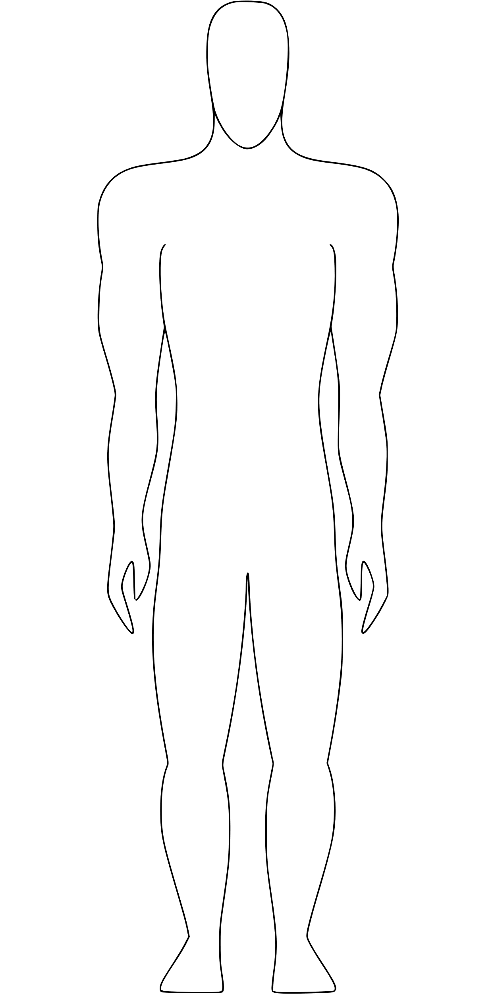
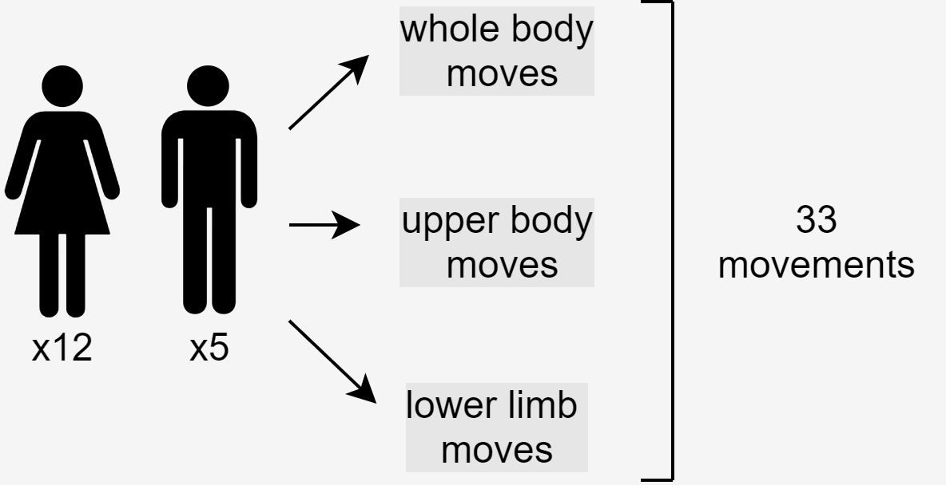
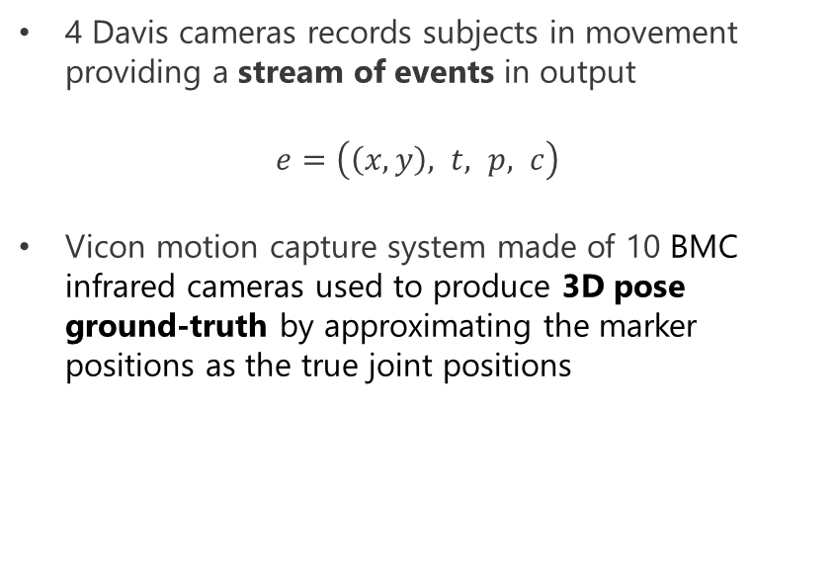
Dataset
DHP19 [1] is the first human pose dataset with data collected from DVS event-based cameras
Recording instruments
4 Davis cameras records subjects in movement providing a stream of events in output
$e=\left(\left(x,y\right), t, p, c\right)$
Vicon motion capture system made of 10 BMC infrared cameras used to produce 3D pose ground-truth by approximating the marker positions as the true joint positions
Human pose is represented by 13 joints
[1] E. Calabrese, G. Taverni, C. Awai Easthope, S. Skriabine, F. Corradi, L. Longinotti, K. Eng, T. Delbruck, DHP19: Dynamic Vision Sensor 3D Human Pose Dataset, in Proceedings of the IEEE/CVF Conference on Computer Vision and Pattern Recognition (CVPR) Workshops (2019)
Notes:
Ne usiamo solo 2 cam2 cam 3

Slide 7
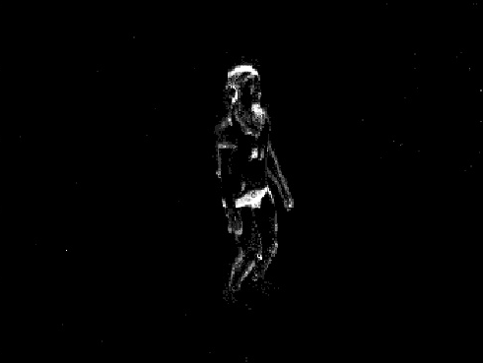
Event preprocessing
Frame generation
Sum of predicted heatmap
Label preprocessing
Fixed amount of events (around 7.5k per camera), are grouped in each frame.
Follow a final normalization in range [0,255].
Labels generation requires to consider initial and final event timestamps for each frame in order to calculate the average position in that temporal window. So labels are temporally aligned to DVS frames.
An intermediate step maps 3D label positions into frame space rounding to the nearest pixel, making use of projection matrices for each camera view.
Finally a smoothing filter is applied on each heatmap through Gaussian blurring with a sigma of 2 pixels.
Sum of label heatmaps
Generic frame obtained from events

Slide 8
Methods and models

Slide 9
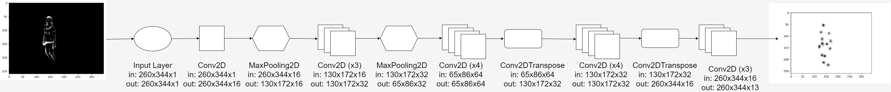
Single-Input Single-Output model (SISO)
Trainable parameters = 218.592
Loss function = Mean Squared Error
Optimizer = RMSProp
Notes:
Parlare dei parametri, di cosa si da in input e cosa restituisce in output
Rmsprop root mean square prop

Slide 10
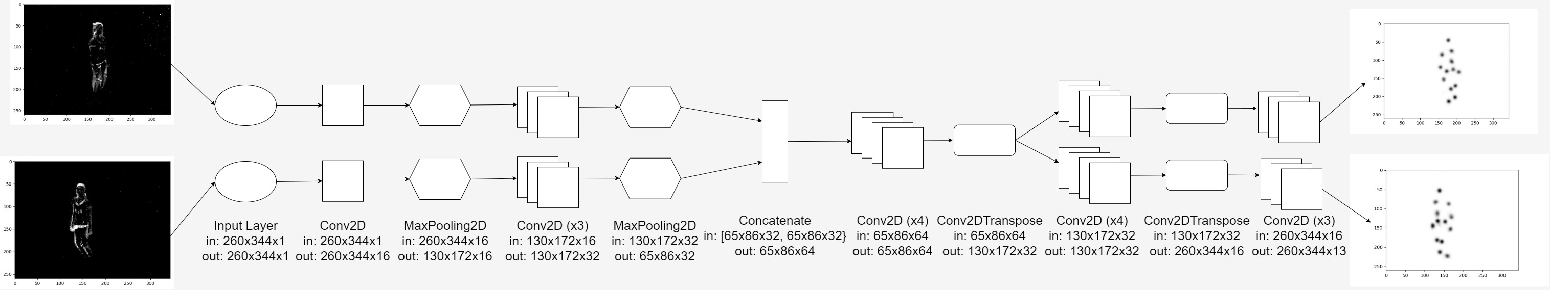
Multi-Input Multi-Output model (MIMO)
Trainable params = 308,16
Loss function = Mean Squared Error
Optimizer = RMSProp
Notes:
Trainable params +30% compared to SIMO model
Loss somma delle loss dei 26 output

Slide 11
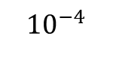
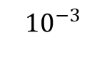
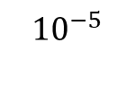
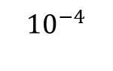
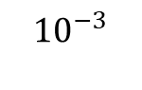
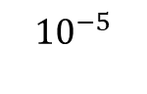
Experimental protocol
SISO Model
MIMO Model
Batch size = 64
Epochs = 20
Training time = 80h
Learning rate:
Batch size = 64
Epochs = 20
Training time = 70h
Learning rate:
$${10}^{−3}$$
$${10}^{−4}$$
$${10}^{−5}$$
$${10}^{−3}$$
$${10}^{−4}$$
$${10}^{−5}$$
1
10
15
20
1
10
15
20
Notes:
Training time -> 308 000

Slide 12
Data generator
1
2
3
4
5
6
7
8
1
2
3
4
5
6
7
8

Slide 13
Data generator
1
2
3
4
5
6
7
8
4
6
7
1
3
8
5
2

Slide 14
Data generator
1
2
3
4
5
6
7
8
4
6
7
1
3
8
5
2
First batch
Second batch

Slide 15
Testing
Evaluation metric:
J = number of joints
Notes:
Explain how the prediction is done
For evaluation purposes we use the mean per joint position error (MPJPE), commonly used in HPE. MPJPE is equivalent to the average Euclidean distance between ground-truth and prediction, and can be calculated both in 2D and 3D space (respectively in pixel and mm) :
where J is the number of the skeleton joints, and xi and ˆxi are respectively the ground-truth and predicted position of the i-th joint in the world or image space.

Slide 16
3D Triangulation
3D projection
3D joint position
Point at minimum distance from the two rays passing through the back-projected point of each camera and the respective camera center C.
Notes:
una volta ottenute le predizioni 2D di entrambe le camere, è possibile spostarsi nello spazio 3D utilizzando le matrici di proiezione delle camere e usare la triangolazione per determinare la posizione del giunto nello spazio 3D

Slide 17


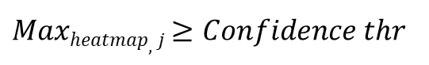
Confidence mechanism
Update with current joint position
To note:
How it works?
Efficacy strongly depends on heatmap’s average max value
$Maxheatmap,j$ ≥ $Confidence thr$
Last good joint position is taken
Higher confidence thresholds ⇏ better performance
No confidence threshold
Optimal confidence threshold
Subject 13 Session 2 Move 4 Frame 62
Notes:
Il meccanismo della confidenza funziona confrontando il massimo valore dell’heatmap in output al modello con il valore di soglia settato per ogni giunto. In caso la condizione non sia soddisfatta, viene utilizzata per quel frame l’ultima posizione del giunto che ha superato la soglia. Un alto valore di confidenza induce un basso numero di aggiornamenti, portando ad un gap temporale sempre più grande tra la predizione attuale e l’ultima predizione che soddisfa la condizione. Quindi Il valore ottimo della confidenza sarà funzione della media dei massimi delle predizioni di tutte le heatmap di tutti i frame e porta miglioramenti quando la predizione è incerta.

Slide 18
Results

Slide 19
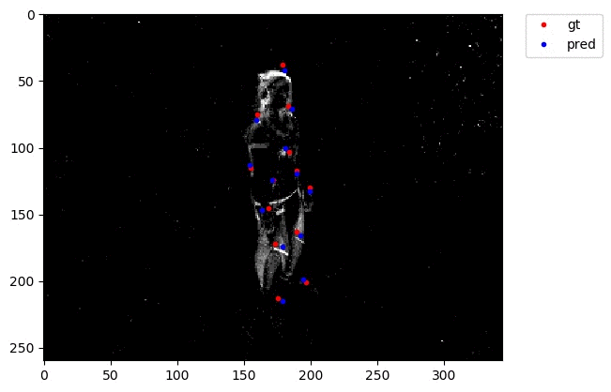
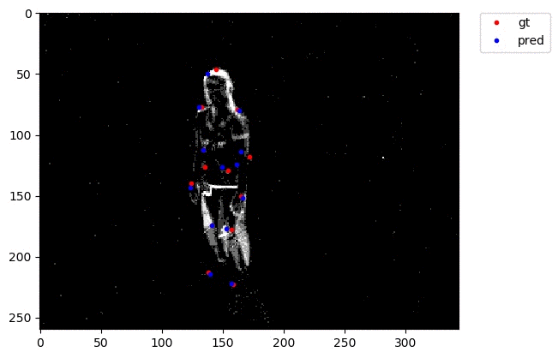
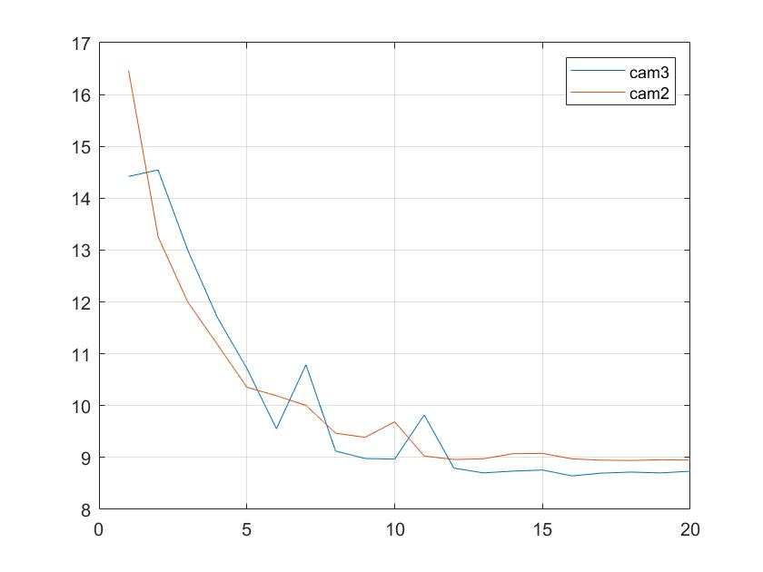
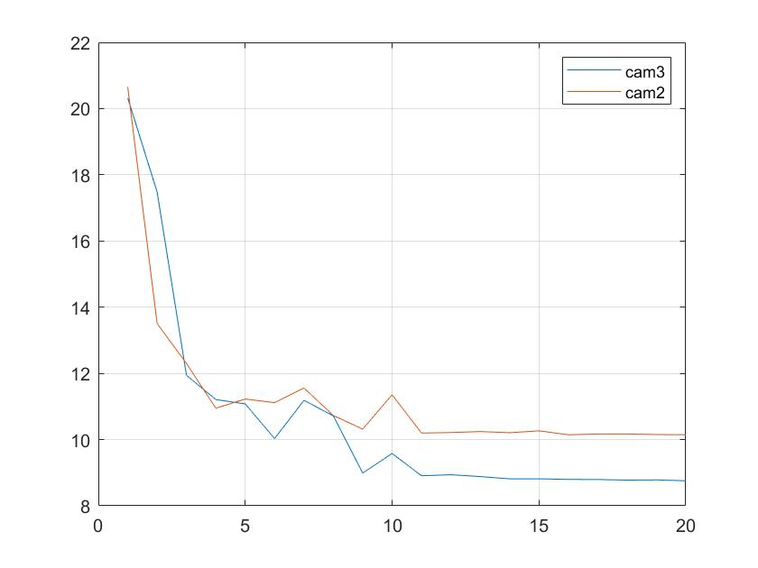
Results
2D prediction
Cam2,3 - Subject 13, Session 2, Move 4 Frames 0-75
SIMO MPJPE trend through 20 epochs
MIMO MPJPE trend through 20 epochs
Notes:
Innanzi tutto, in basso a sinistra l’andamento dell’MPJPE sui soggetti di validation per entrambi i modelli. Infatti nonostante nel training la val_loss sia l’MSE, abbiamo deciso di utilizzare la stessa metrica per valutare i soggetti di validation con la stessa metrica con cui abbiamo valutato i soggetti di test e si vede come per entrambi i modelli l’andamento converge. Per quanto riguarda i risultati del test, le architetture proposte non portano miglioramenti rispetto al modello di baseline, ma con l’architettura multiple input multiple output si ha un miglioramento del 2% rispetto l’architettura SISO. I valori ottimi per ogni modello corrispondono a valori di confidence diversi, comunque portano ad un miglioramento die risultati fino al 6%.

Slide 20
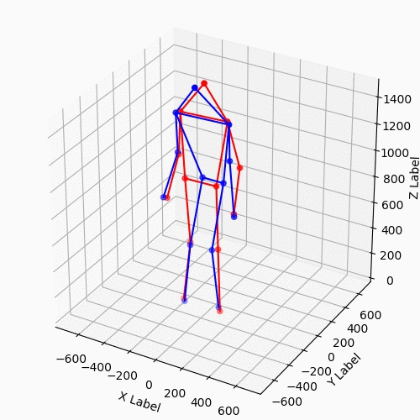
Results
3D prediction
Notes:
Questi sono i risultati della triangolazione 3D ottenute partendo dalle predizioni 2D corrispondenti ai valori ottimali di confidenza di tutti e 3 i modelli. In grassetto la media totale di tutti i frame calcolata in millimetri. Anche qua l’utilizzo di un’architettura MIMO porta ad un miglioramento di oltre il 2%. È anche interessante notare come i migliori risultati si ottengano per la sessione 2 per tutti e 3 i modelli. I movimenti di questa sessione infatti riguardano tutto il corpo, quindi l’intera figura umana è visibile nel frame DVS

Slide 21
Discussions and conclusions

Slide 22
Discussions & Conclusions
Discussions
Future works
No improvements for baseline results
training hyperparameters
data generator mechanism
output normalization
MIMO architecture improvements
Inputs with similar features
Use of cam-specific layer
Different training hyperparameters
MIMO architecture configuration
Direct 3D prediction
Imposing kinematic constraining in state estimation
Notes:
The more reasonable one regards the training hyperparameters, especially for SIMO model in which CNN architecture has not be modified. For example, the setting of a different batch size or learning rate scheduling, according to the evaluation metrics trend among epochs, could lead to performance improvements. Other reasons could be linked to the data generator mechanism, which may led to a different training procedure, or to another kind of output normalization.
However, the new MIMO model architecture allowed to get improvements compared to SIMO model. This can be explained by considering that the inputs given to the model have very similar features since they correspond to 2 different points of view of the same instant of time, and so using shared layers could increase accuracy, as well as guaranteeing lower inference time. Future works could be related to explore different training hyperparameters, as those above mentioned, in order to find additional improvements. About MIMO model architecture, it could be interesting to find the optimal configuration considering to share a different number of layers or a new method of selection. As described in 5.2, also the use of a final softmax layer could introduce new test and observations. Finally, more ambitious projects could aim at implementing 3D CNN for obtaining a direct 3D HPE, in order to overcome geometric methods as triangulation or imposing kinematic constraining in state estimation, avoiding impossible joint position’s prediction.
Mimo architecture config ->Different shared layers Dirent number of sahre layers

Slide 23
Thanks for your attention

Slide 24
